Slide 1
Authentication Mechanisms
Dr Zia ur Rehman

Slide 2
Authentication
Authentication is the process of verifying the identity of a user or system.
An authentication mechanism is a method or process used to confirm the identity of a user or system, and it ensures that only authorized individuals or systems have access to specific resources.
In other words, it is process of determining whether some user or some application or process acting on behalf of a user is, in fact, who or what it declares itself to be.

Slide 3
Authentication Mechanisms / Means
There are three general means, or authentication factors, of authenticating a user’s identity, which can be used alone or in combination.
Knowledge factor (something the individual knows): knowledge factors can come in the form of passwords, passphrases, personal identification numbers (PINs), or answers to secret questions.
Possession factor (something the individual possesses): Physical entity possessed by the authorized user to connect to the client computer or portal, referred as token.
Inherence factor (something the individual is or does): Refers to characteristics, called biometrics, that are unique or almost unique to the individual.
Notes:
Connected hardware tokens are items that connect to a computer logically (e.g., via wireless) or physically in order to authenticate identity. Items such as smart cards, wireless tags, and USB tokens are common connected tokens used to serve as a possession factor. Disconnected hardware tokens are items that do not directly connect to the client computer, instead requiring input from the individual attempting to sign in. Typically, a disconnected hardware token device will use a built-in screen to display authentication data that are then utilized by the user to sign in when prompted.
static biometrics, such as fingerprint, retina, and face; and dynamic biometrics, such as voice, handwriting, and typing rhythm

Slide 4
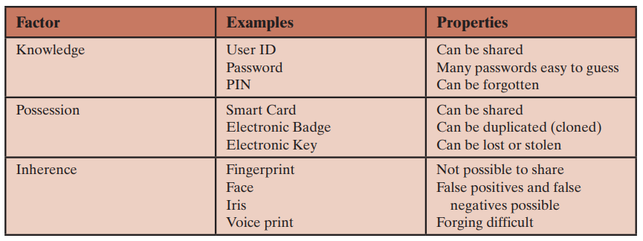
Authentication Factors
Notes:
Connected hardware tokens are items that connect to a computer logically (e.g., via wireless) or physically in order to authenticate identity. Items such as smart cards, wireless tags, and USB tokens are common connected tokens used to serve as a possession factor. Disconnected hardware tokens are items that do not directly connect to the client computer, instead requiring input from the individual attempting to sign in. Typically, a disconnected hardware token device will use a built-in screen to display authentication data that are then utilized by the user to sign in when prompted.
static biometrics, such as fingerprint, retina, and face; and dynamic biometrics, such as voice, handwriting, and typing rhythm

Slide 5
Password Authentication
Basic idea
User has a secret password
System checks password to authenticate user
Issues
How is password stored?
How does system check password?
How easy is it to guess a password?
Difficult to keep password file secret, so best if it is hard to guess password even if you have the password file

Slide 6
Basic password scheme
User
Password file
kiwifruit
exrygbzyf
kgnosfix
ggjoklbsz
…
…
hash function

Slide 7
Basic Password Scheme
Hash function h : strings → strings
Given h(password), hard to find password
No known algorithm better than trial and error
User password stored as h(password)
When user enters password
System computes h(password)
Compares with entry in password file
No passwords stored on disk
Notes:
A hash function H accepts a variable-length block of data M as input and produces a fixed-size result h = H(M), referred to as a hash value or a hash code.
A cryptographic hash function is an algorithm for which it is computationally infeasible (because no attack is significantly more efficient than brute force) to find either (a) a data object that maps to a pre-specified hash result (the one-way property) or (b) two data objects that map to the same hash result (the collision-free property).

Slide 8
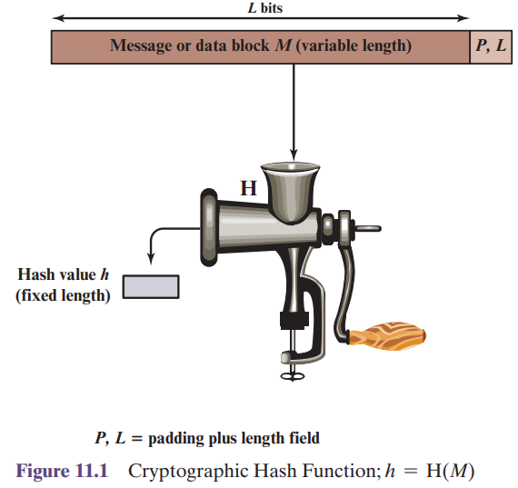
Cryptographic Hash Function
Notes:
A hash function H accepts a variable-length block of data M as input and produces a fixed-size result h = H(M), referred to as a hash value or a hash code.
A cryptographic hash function is an algorithm for which it is computationally infeasible (because no attack is significantly more efficient than brute force) to find either (a) a data object that maps to a pre-specified hash result (the one-way property) or (b) two data objects that map to the same hash result (the collision-free property).

Slide 9
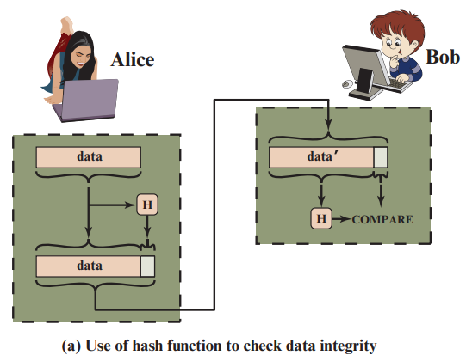
Message Authentication

Slide 10
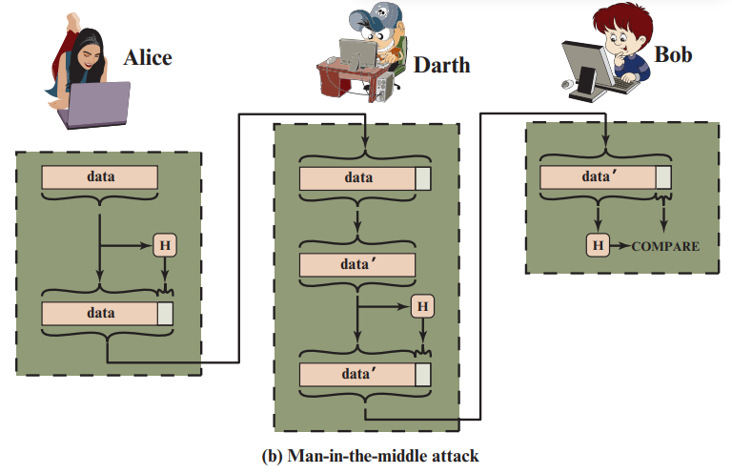
Message Authentication

Slide 11
Salt
Password line
walt:fURfuu4.4hY0U:129:129:Belgers:/home/walt:/bin/csh
Compare
Salt
Input
Constant,
A 64-bit block of 0
Key
25x DES
Ciphertext
Plaintext
When password is set, salt is chosen randomly
12-bit salt slows dictionary attack by factor of 2¹²
Notes:
In the context of authentication mechanisms, "salt" refers to a random sequence of data that is added to a password before it is hashed. The purpose of using a salt is to make it more difficult for attackers to use precomputed tables, such as rainbow tables, to crack passwords.
In Unix/Linux systems, user account information is stored in the /etc/passwd file, where each line has seven fields separated by colons, structured as follows:
account:coded password data:uid:gid:GCOS-field:homedir:shell
Salt: 12 bits encoded in 2 bytes
Ciphertext: 11 bytes
It is much harder to infer the key than to infer the clear text.

Slide 12
Dictionary Attack – some numbers
Typical password dictionary
1,000,000 entries of common passwords
people's names, common pet names, and ordinary words.
Suppose you generate and analyze 10 guesses per second
This may be reasonable for a web site; offline is much faster
Dictionary attack in at most 100,000 seconds = 28 hours, or 14 hours on average
If passwords were random
Assume six-character password
Upper- and lowercase letters, digits, 32 punctuation characters
689,869,781,056 password combinations.
Exhaustive search requires 1,093 years on average

Slide 13


Biometrics
Use a person’s physical characteristics
fingerprint, voice, face, keyboard timing, …
Advantages
Cannot be disclosed, lost, forgotten
Disadvantages
Cost, installation, maintenance
Reliability of comparison algorithms
False positive: Allow access to unauthorized person
False negative: Disallow access to authorized person
Privacy?
If forged, how do you revoke?

Slide 14

Biometrics
Common uses
Specialized situations, physical security
Combine
Multiple biometrics
Biometric and PIN
Biometric and token
Notes:
Multifactor authentication refers to the use of more than one of the authentication means in the preceding list.

Slide 15
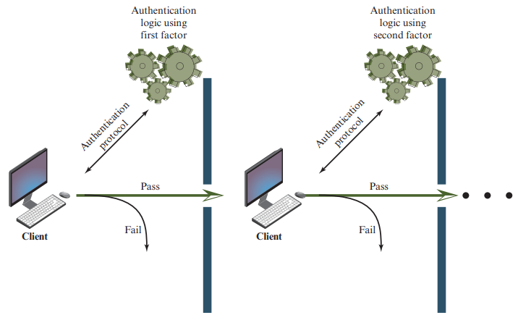
Multifactor Authentication
Notes:
Multifactor authentication refers to the use of more than one of the authentication means in the preceding list.

Slide 16
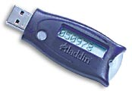
Token-based Authentication Smart Card
With embedded CPU and memory
Carries conversation w/ a small card reader
Various forms
PIN protected memory card
Enter PIN to get the password
Cryptographic challenge/response cards
A cryptographic key in memory
Computer create a random challenge
Enter PIN to encrypt/decrypt the challenge w/ the card
Cryptographic Calculator (readerless smart card)
Simulating a smartcard: user enter the encrypted result
Notes:
PIN protected: usually the password is much harder to memorize. Also, you need both PIN and smart card for authentication.
Sometimes, no random challenge for cryptographic challenge/response cards, eg, the crypto calculator.

Slide 17
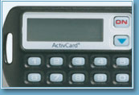
Smart Card Example
Initial data
Time
Challenge
Time
function
Some complications
Initial data shared with server
Need to set this up securely
Shared database for many sites
Clock skew

